Slide 1

Introduction to Automation Testing
Module 1

Slide 2
Overview of Automation Testing
What is Software Automation Testing?
The use of software tools to automatically perform testing tasks.
Involves the execution of pre-scripted tests on the software.
Aims to improve efficiency, coverage, and accuracy of tests.

Slide 3
Overview of Automation Testing
Why Use Automation Testing?
Increased Speed and Efficiency: Automated tests can run faster and more frequently.
Cost-Effective for Repetitive Tests: Reduces the manual effort required for regression tests.
Consistency: Automated tests eliminate the human error factor.
Better Coverage: Allows testing of more scenarios with large data sets.
Faster Feedback: Quick feedback on software performance and functionality.

Slide 4
Overview of Automation Testing
Common Challenges of Automation Testing
High Initial Setup Cost: Requires investment in tools and training.
Maintenance of Test Scripts: Automated test scripts require regular updates due to code changes.
Limited for Certain Tests: Some tests, such as usability testing, are difficult to automate.
Complexity: Setting up an automation environment and writing test scripts can be complex.

Slide 5
Overview of Automation Testing
Types of Tests Suitable for Automation
Tests that are repetitive and time-consuming:
Regression testing, which checks that new code changes haven't broken existing functionality.
Smoke testing, to check basic functionality after a new build.
Tests that require large data sets:
Performance testing and load testing to handle multiple users and stress conditions.
Tests that require high precision:
Unit tests for individual code components.

Slide 6
Overview of Automation Testing
Scenarios Where Automation May Not Be Beneficial
One-Time Tests: Tests that are run once, such as ad-hoc or exploratory tests.
Tests that Are Difficult to Automate: Usability or visual interface tests that require human judgment.
Rapidly Changing Applications: Frequent changes to the UI or functionality may make automated tests hard to maintain.
Small Projects with Limited Budget: Small-scale applications or projects may not justify the initial cost of automation.

Slide 7
Overview of Automation Testing
Scenarios Where Automation May Not Be Beneficial
One-Time Tests: Tests that are run once, such as ad-hoc or exploratory tests.
Tests that Are Difficult to Automate: Usability or visual interface tests that require human judgment.
Rapidly Changing Applications: Frequent changes to the UI or functionality may make automated tests hard to maintain.
Small Projects with Limited Budget: Small-scale applications or projects may not justify the initial cost of automation.

Slide 8
Overview of Automation Testing
Automation Testing Life Cycle
Test Planning: Identifying which tests to automate.
Test Tool Selection: Choosing the appropriate tools based on the application and testing needs.
Test Script Development: Writing and developing automated test scripts.
Test Execution: Running the automated tests.
Defect Reporting: Logging any issues or failures.
Maintenance: Updating the automation scripts to adapt to changes in the application.

Slide 9
Introduction to Selenium
What is Selenium?
Selenium was invented in 2004 by Jason Huggins, a software engineer at ThoughtWorks
Selenium is an open-source framework for automating web applications.
It provides a suite of tools to automate browsers across different platforms.
Components of Selenium
Selenium WebDriver: Interacts directly with the browser, simulating real user actions.
Selenium IDE: A browser extension for recording and playback of tests.
Selenium Grid: Allows parallel execution of tests across multiple machines and environments.

Slide 10
Introduction to Selenium
Key Features
Cross-browser Testing: Supports browsers like Chrome, Firefox, Safari, Edge.
Multi-platform Support: Can be used on Windows, Linux, macOS.
Language Support: Works with multiple programming languages like Java, Python, C#, Ruby, JavaScript.
Integration with Testing Frameworks: Compatible with tools like TestNG, JUnit, and Maven for test management.
Why Use Selenium?
Widely adopted for web application testing due to its flexibility and scalability.
Free and open-source.
Supports automation for both functional testing and regression testing.

Slide 11
Why C# for Selenium
Strong Integration with .NET Framework
Rich Language Features (object-oriented capabilities)
Parallel Test Execution with NUnit and MSTest
Easy Integration with Continuous Integration Tools
IntelliSense and Visual Studio Features

Slide 12
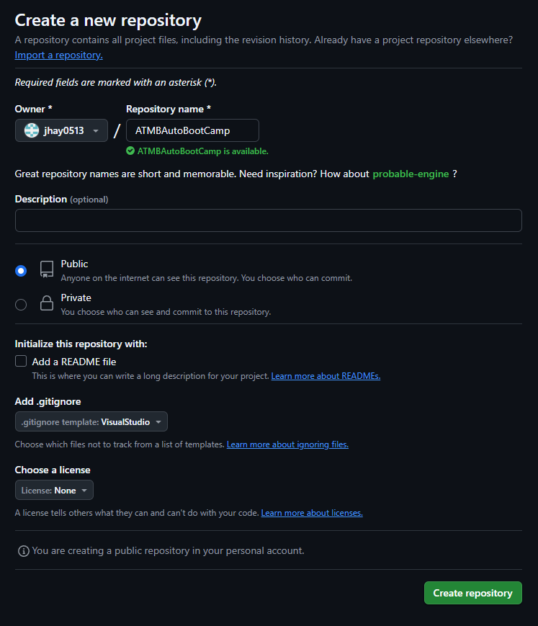

Hands-on Activity
Signup on https://github.com/signup using personal account
Create a Public Repository
Copy Repository Link
Paste Repository Link on the tracking sheet
Download GitHub Desktop Application https://desktop.github.com/download/
Clone your created repository in your local machine

